Slide 1




ImpacTech 2k24
FARMSCAPE
Securing the future, one harvest at a time.

Slide 2

Content
01
Our Team
02
Introduction
03
Problem Statement
04
Solution Breakdown
05
Implementation
06
Conclusion
07
Contact

Slide 3



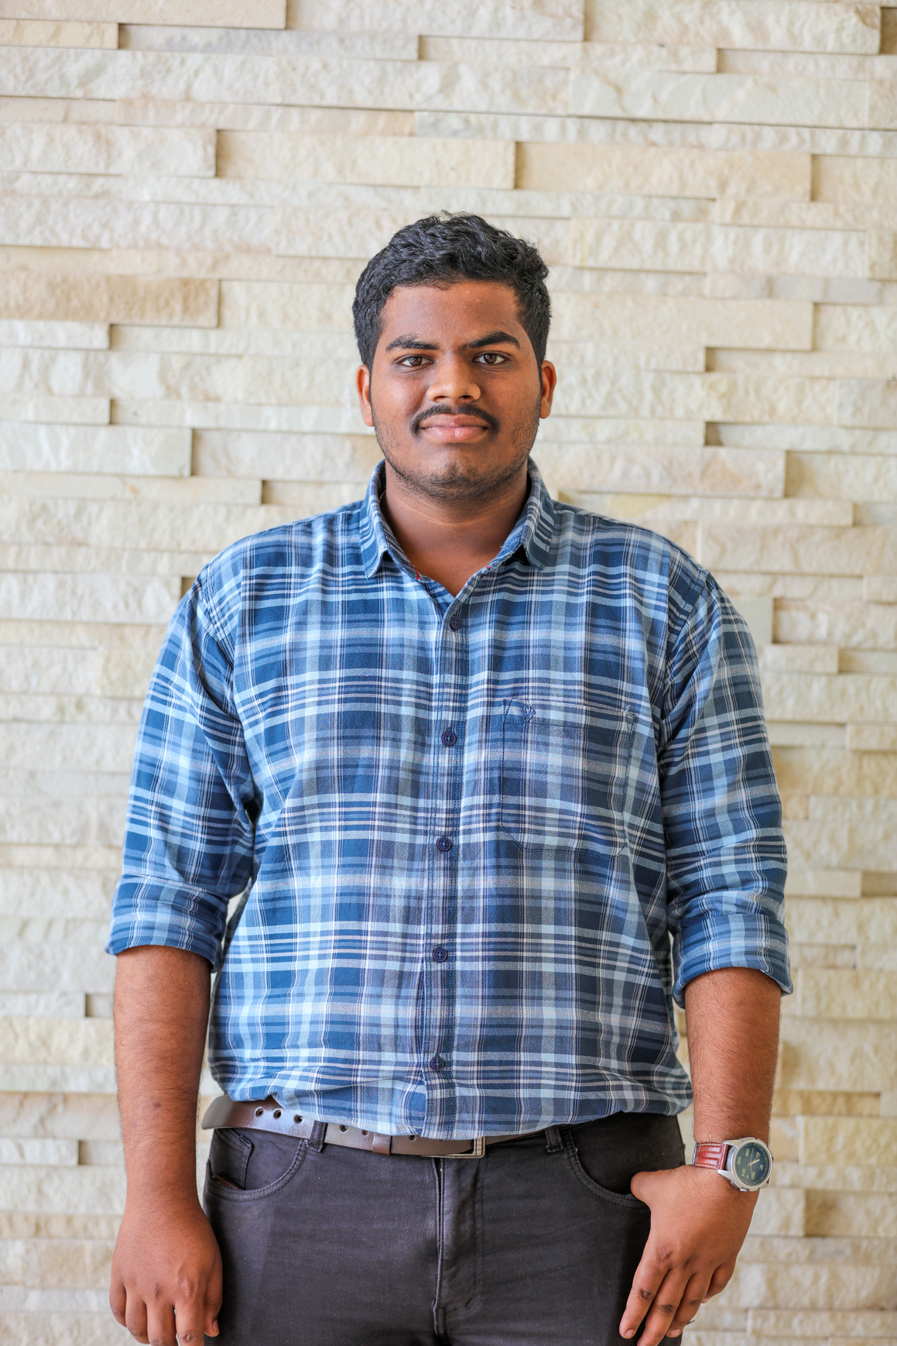




Our Team
Vedardha
Dinakar
Shreeram
Teja
Varun
2210030091
2210030004
2210030024
2210030064
2210030078

Slide 4


Problem Statement
FARMSCAPE IS WORKING ON AN INNOVATIVE SOLUTION FOR FARMERS - AN INTEGRATED SYSTEM THAT EMPLOYS AI-POWERED IMAGE PROCESSING TO DETECT WEEDS AND DISEASES IN CROPS. BY DOING SO, THE SYSTEM CAN OPTIMIZE THE HEALTH AND YIELD OF THE CROPS WHILE REDUCING THE NEED FOR HERBICIDES AND PESTICIDES. THROUGH THIS ECO-FRIENDLY APPROACH, FARMSCAPE AIMS TO CREATE A SUSTAINABLE AND RESILIENT AGRICULTURAL ECOSYSTEM WHERE TECHNOLOGY PLAYS A VITAL ROLE.

Slide 5





Overview
01
Weed Detection
The future of agriculture lies in advanced automation technologies and data-driven precision farming practices, aiming to optimize efficiency, sustainability, and resilience in food production.
02
Farming Automation
03
Auto Irrigation
04
Plan Disease Detection

Slide 6





Objectives
Objective 01
To reduce our Farmers work by automating major steps
Objective 02
Easy Weed Detection / Disease Detection in a Mega Farmland
Objective 03
Automated irrigation
Objective 04
Ultimately the detection progams are going to be free to use on Android

Slide 7
TIMELINE

Slide 8





4th Quarter
Testing and Fine Tuning
3rd Quarter
Timeline
Work on The solutions
2nd Quarter
Research About the Solutions
1st Quarter
Identify the Solutions Possible

Slide 9

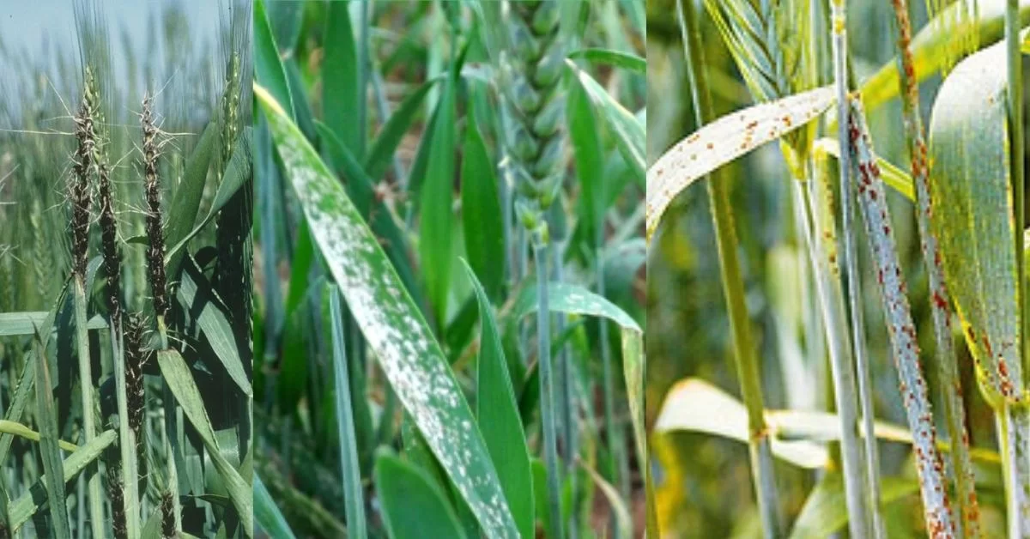


Statistics
We have found that due to weed , plant diseases , we may lose about 33% to 50% of our Yield
50%
Losses

Slide 10





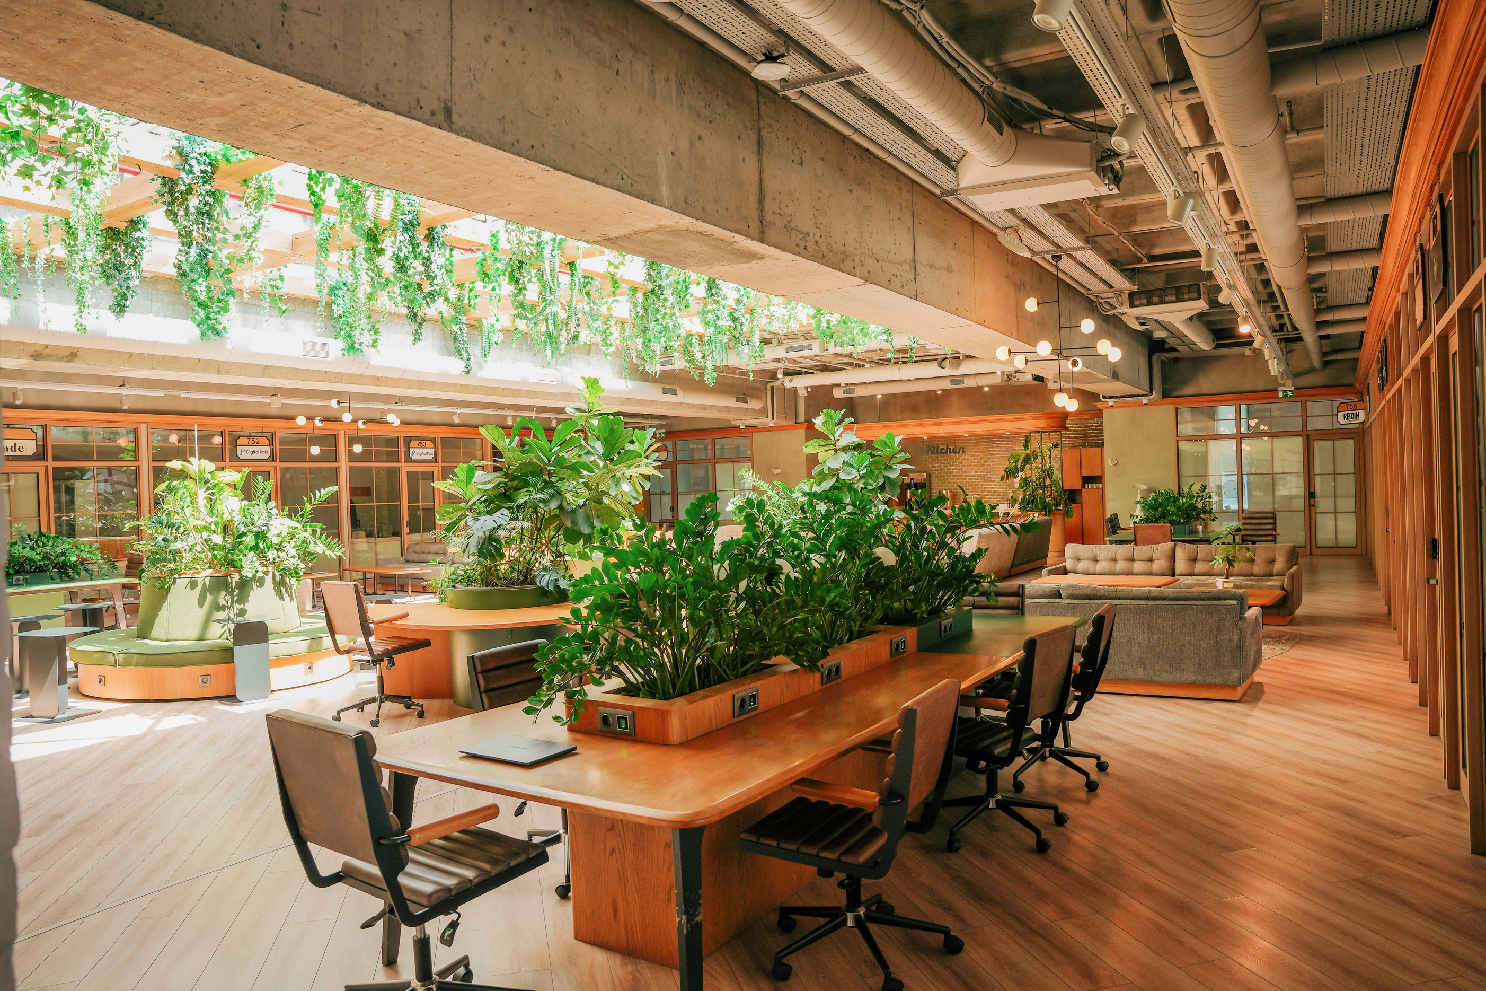
Future goals
01
Enhance the Accuracy
Continued advancements in machine learning algorithms and deep learning techniques can lead to higher accuracy rates in plant/weed detection.
02
Real time Solution
Integration of AI-powered plant/weed detection systems with drones, robots, or other automated agricultural machinery for real-time monitoring and management of crops.
03
Developing farming systems that are resilient to climate change-related challenges, such as extreme weather events, droughts, and shifting growing seasons.

Slide 11
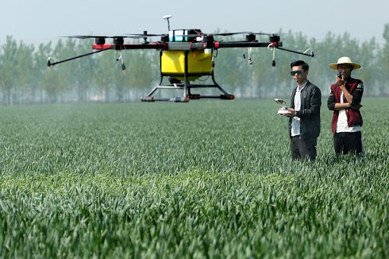

THANK YOU

